Slide 1
Semantic Analysis

Slide 2
What Is Semantic Analysis?
The purpose of semantic analysis is to draw exact meaning, or you can say dictionary meaning from the text. The work of semantic analyzer is to check the text for meaningfulness.
How is semantic analysis different from lexical analysis?
Lexical analysis also deals with the meaning of the words, then Lexical analysis is based on smaller token but on the other side semantic analysis focuses on larger chunks.

Slide 3
Parts of Semantic Analysis
Semantic analysis can be divided into the following two parts −
Studying meaning of individual word
It is the first part of the semantic analysis in which the study of the meaning of individual words is performed. This part is called lexical semantics.
Studying the combination of individual words
In this second part, the individual words will be combined to provide meaning in sentences that leads to compositional semantics.

Slide 4
Lexical Semantics
The first part of semantic analysis, studying the meaning of individual words is called lexical semantics.
It includes words, sub-words, affixes (sub-units), compound words and phrases also. All the words, sub-words, etc. are collectively called lexical items.
In other words, we can say that lexical semantics is the relationship between lexical items, meaning of sentences and syntax of sentence.

Slide 5
In order to understand the meaning of a sentence, the following are the major processes involved in Semantic Analysis:
Word Sense Disambiguation
Relationship Extraction

Slide 6
WSD (word sense disambiguation).
Lexical ambiguity, syntactic or semantic, is one of the very first problem that any NLP system faces. Part-of-speech (POS) taggers with high level of accuracy can solve Word’s syntactic ambiguity.
On the other hand, the problem of resolving semantic ambiguity is called WSD (word sense disambiguation).

Slide 7
Word Sense Disambiguation involves interpreting the meaning of a word based upon the context of its occurrence in a text.
Eg: Orange,Date,Bark,rock….
Consider the two examples of the distinct sense that exist for the word “bass” −
I can hear bass sound.
He likes to eat grilled bass
The occurrence of the word bass clearly denotes the distinct meaning. In the first sentence, it means frequency; in the second, it means fish. Hence, if WSD would disambiguate it then the correct meaning of the above sentences can be assigned as follows −
I can hear bass/frequency sound.
He likes to eat grilled bass/fish.

Slide 8
WSD needs inputs like Dictionary and Text Corpus.
Approaches includes
Dictionary-based or Knowledge-based Methods
Lesk Method
Supervised Methods
SVM,Naïve bayes….
Unsupervised Methods
CBOW,skip gram…..

Slide 9
Relationship Extraction
Another important task involved in Semantic Analysis is Relationship Extracting. It involves firstly identifying various entities present in the sentence and then extracting the relationships between those entities.
Includes
Named Entity Recognition
Semantic Role Labeling.

Slide 10
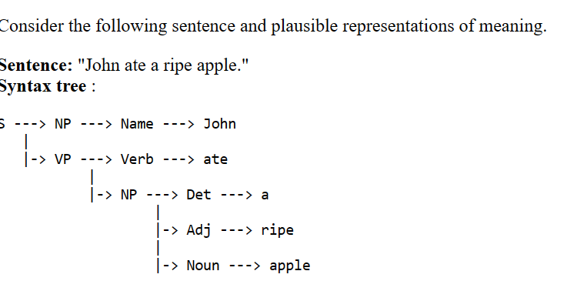
The general theory in compositional semantics: The meaning of a phrase is determined by combining the meanings of its subphrases, using rules which are driven by the syntactic structure.
.

Slide 11
NER(Named Entity Recognition)
The named entity recognition (NER) is one of the most popular data preprocessing task. It involves the identification of key information in the text and classification into a set of predefined categories. An entity is basically the thing that is consistently talked about or refer to in the text.
At its core, NLP is just a two-step process, below are the two steps that are involved:
Detecting the entities from the text
Classifying them into different categories

Slide 12
Some of the categories that are the most important architecture in NER such that:
Person
Organization
Place/ location
Other common tasks include classifying of the following:
date/time.
expression
Numeral measurement (money, percent, weight, etc)
E-mail address

Slide 13
